Slide 1
Operations on Images
Key Arithmetic Operations
Image Addition (Blending/Brightening):
Adds pixel values from two images (e.g., img1 + img2) by f(m,n) + g(m,n)
or adds a constant to all pixels (e.g., img + 50) to lighten an image.
Use: Creating faded effects, merging elements, or increasing overall brightness.
Image Subtraction (Change Detection): f(m,n) - g(m,n).
Subtracts pixel values of one image from another (e.g., img1 - img2)
Use: Detecting differences, motion detection (taking the absolute difference between two frames of a video to highlight moving objects like a person walking), or removing backgrounds (background subtraction).
Multiplication: f(m,n) * g(m,n) .
Use: Adjusting contrast or creating masks. Multiplying by a small constant can darken an image
Division: f(m,n) / g(m,n).
Use: Correcting non-uniform illumination (shading correction) or reducing contrast as dividing by a constant can brighten it.

Slide 2
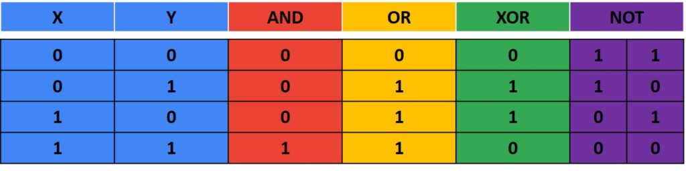
Operations on Images
Logical operations
  Logical operations are fundamental tools in image processing, primarily used for masking regions of interest, feature detection, and shape analysis, especially with binary images. They manipulate images on a pixel-by-pixel basis, allowing for precise control over image content.
AND – True if both pixels are greater than zero
OR – True if either of the two pixels are greater than zero
XOR – True if either of the two pixels are greater than zero, but not both
NOT – Invert pixel values

Slide 3
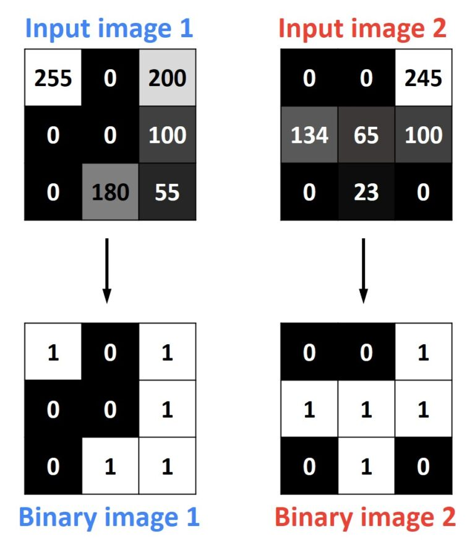
Bitwise operations are applied on grayscale images. First of all, they convert a grayscale into a binary images as you can see in a following example. The rule for conversion is the folowing: any given pixel larger then zero will become one, and zeros will remain zeros. In another words, any given pixel with value “0” is represented with number zero (pixel is turned “off”), and any pixel with value greater than “0” is represented with number one (pixel is turned “on”).

Slide 4
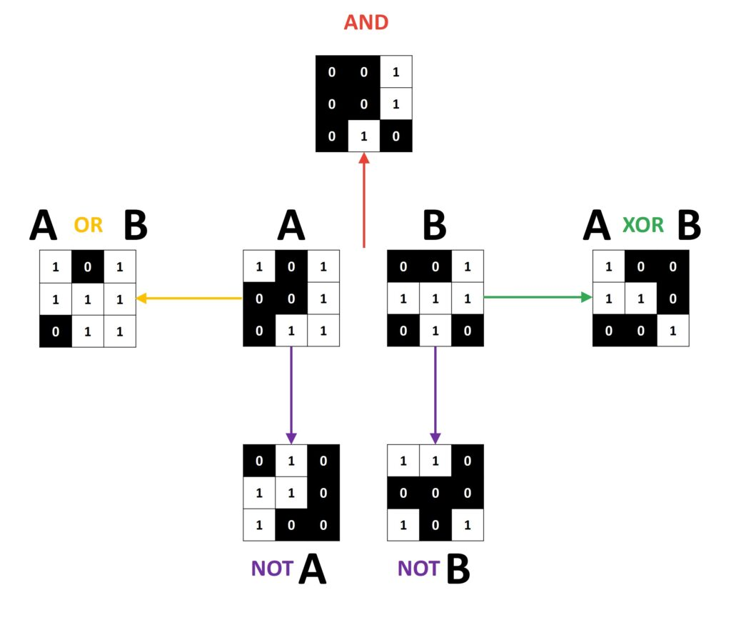
Now lets apply bitwise operations on our binary images.

Slide 5
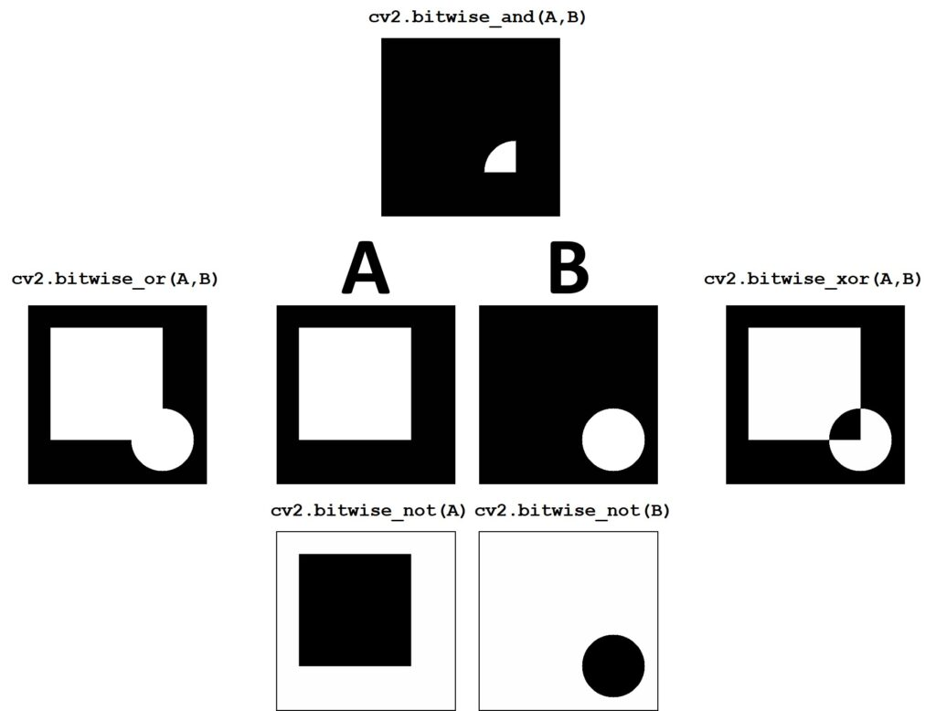

Slide 6
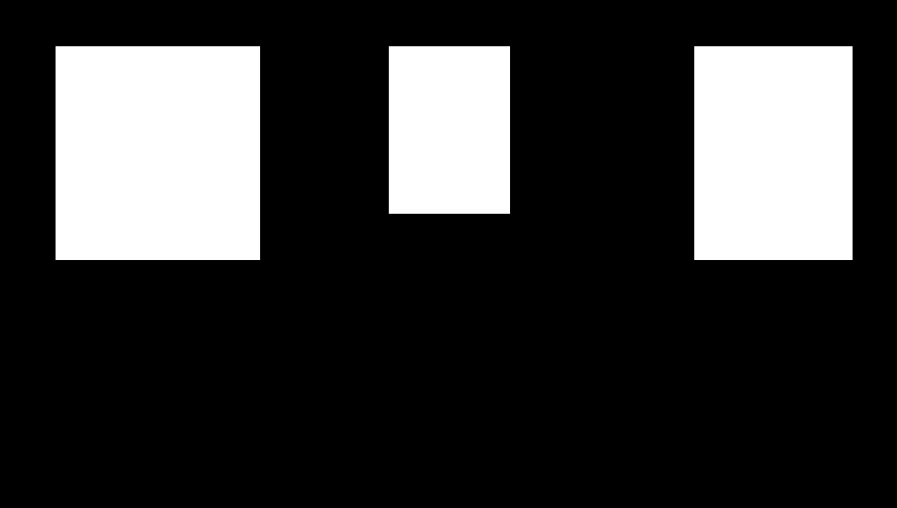
Masking
A extremely useful technique in the image processing is masking, which allows us to focus only on the special part or area of the image.
So, let’s assume that we want to highlight parts of the image with faces on it and ignore the rest of the image. First, we need to construct our mask. We use AND operation to obtain our output.

Slide 7
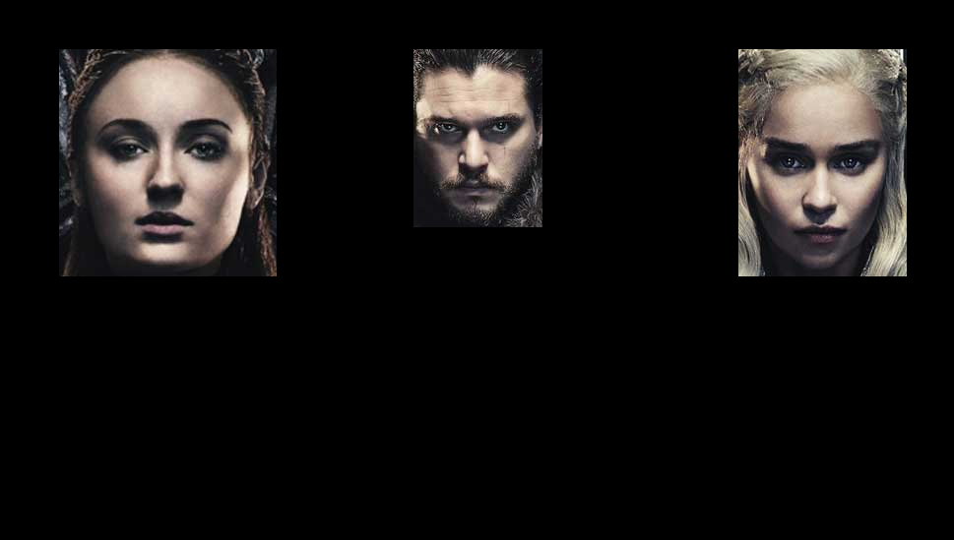
Output

